Slide 1
Unit - 3
Big Data Analytics

Slide 2
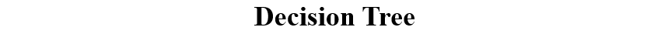
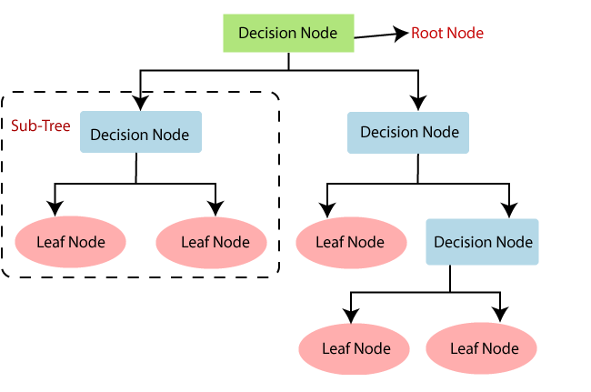

Slide 3
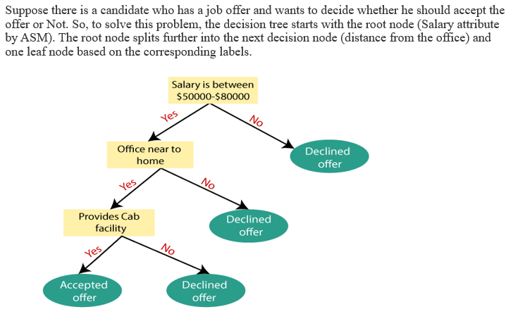

Slide 4
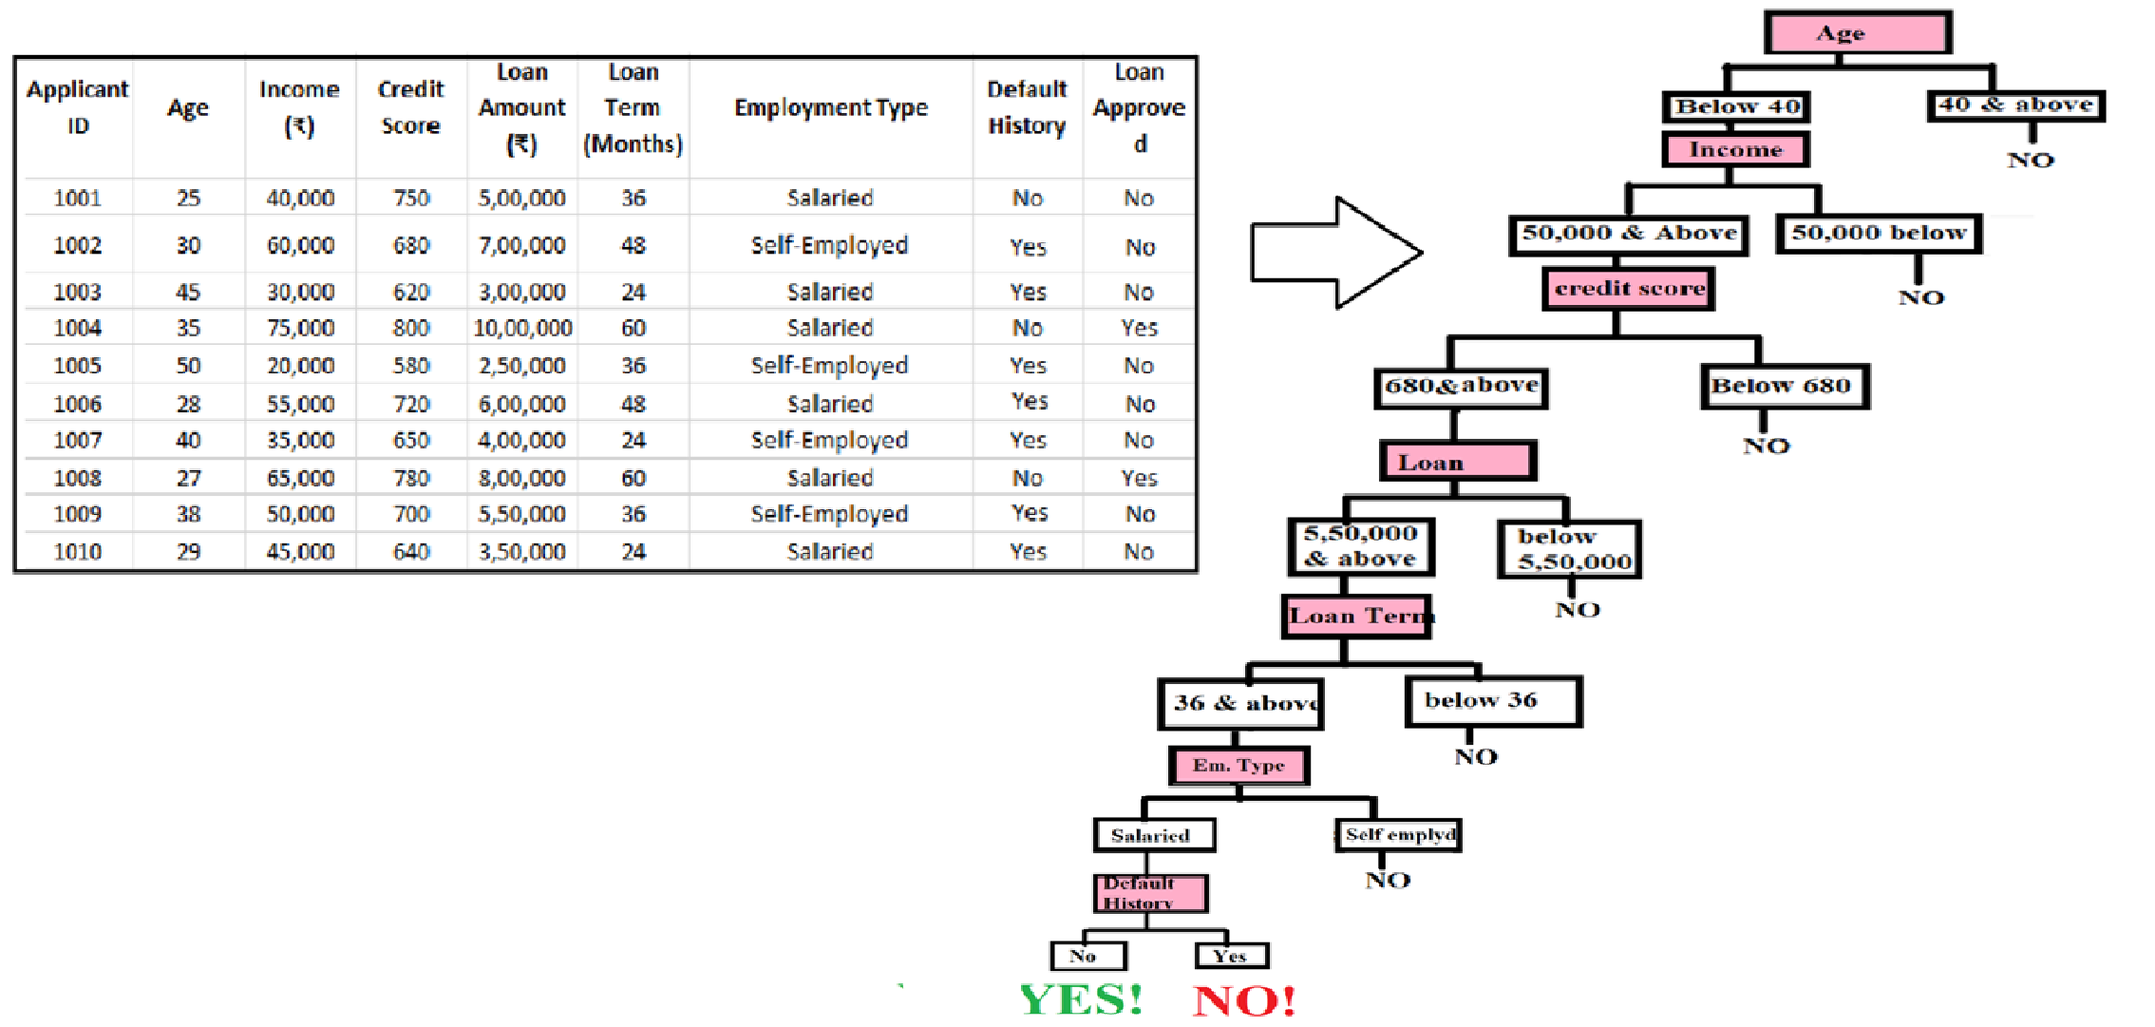
Suppose we have the dataset given below:
This structured approach converts the dataset into a decision tree, helping to classify loan approvals based on various factors.

Slide 5
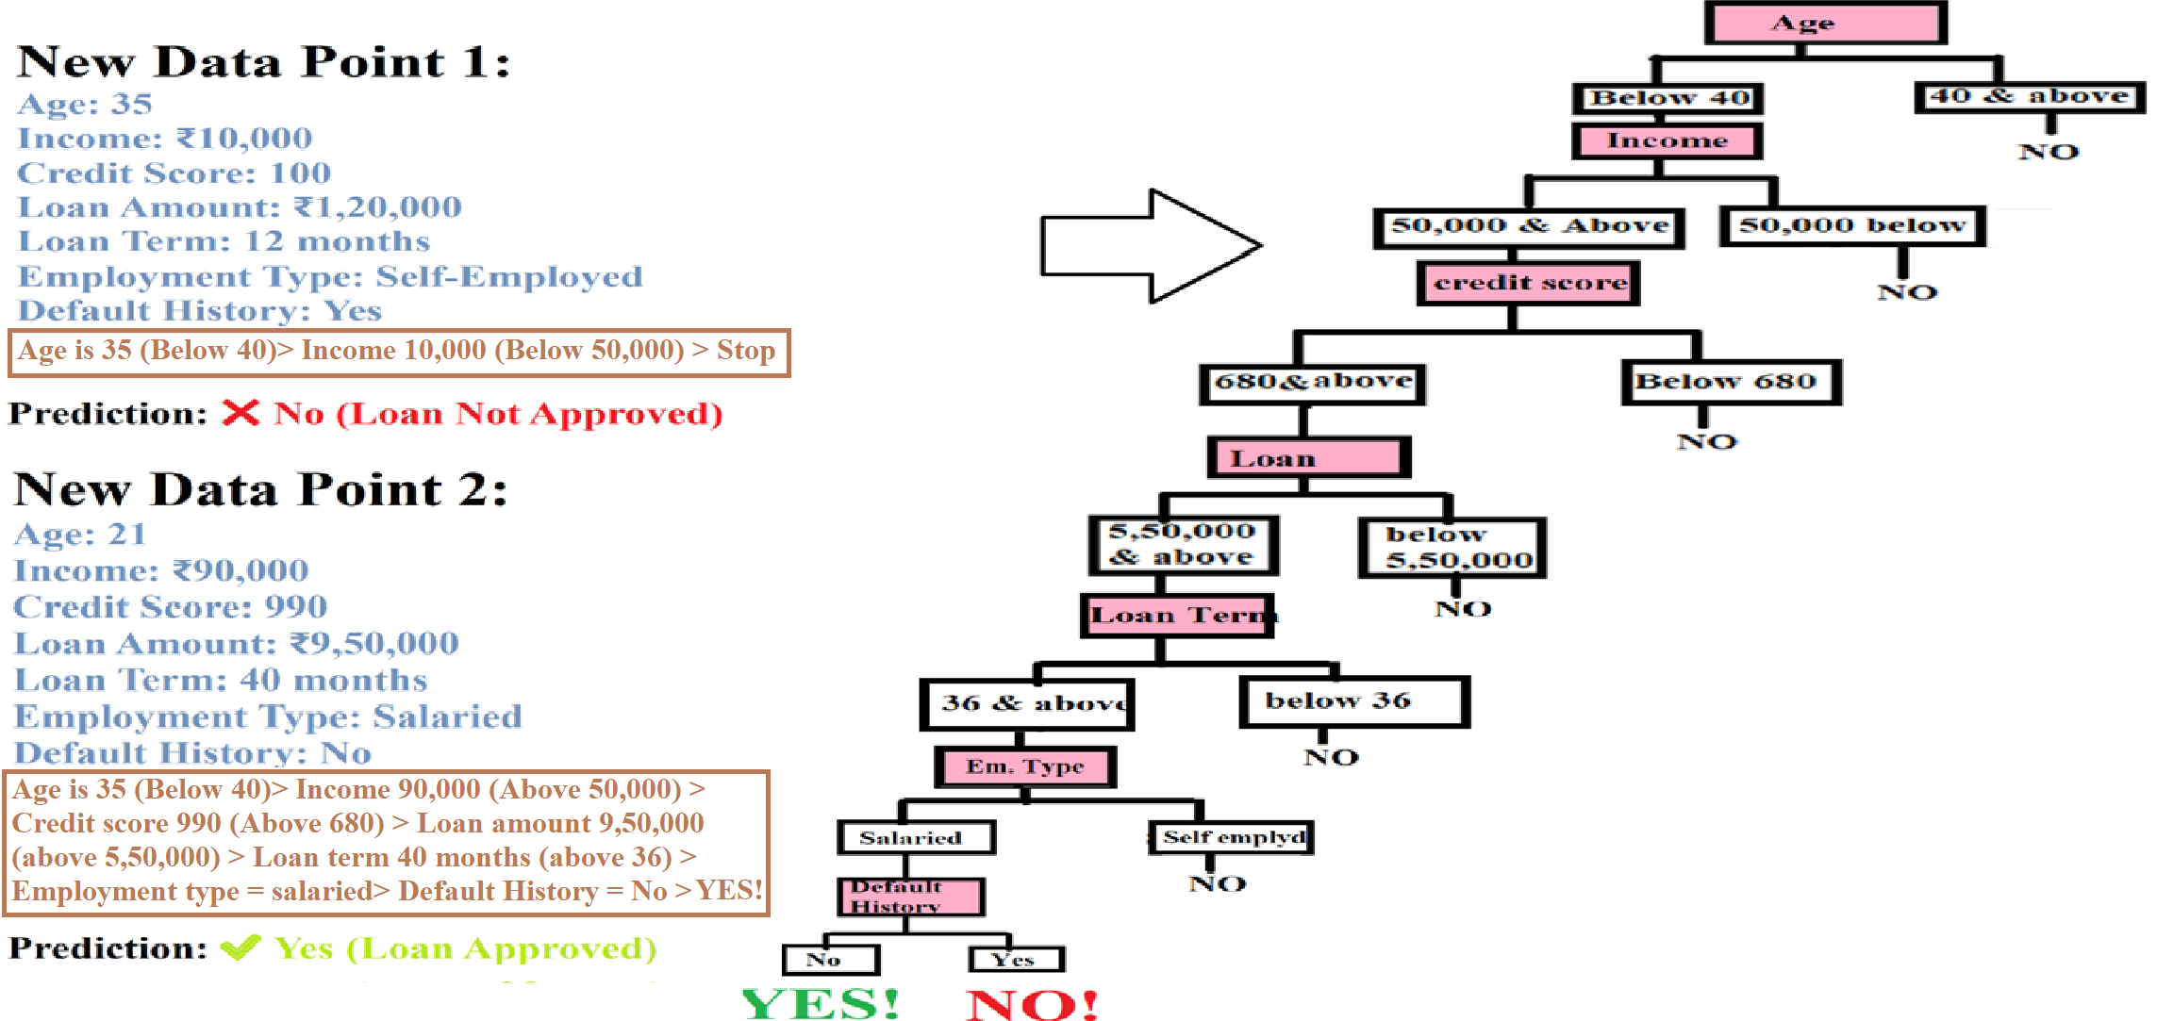

Slide 6
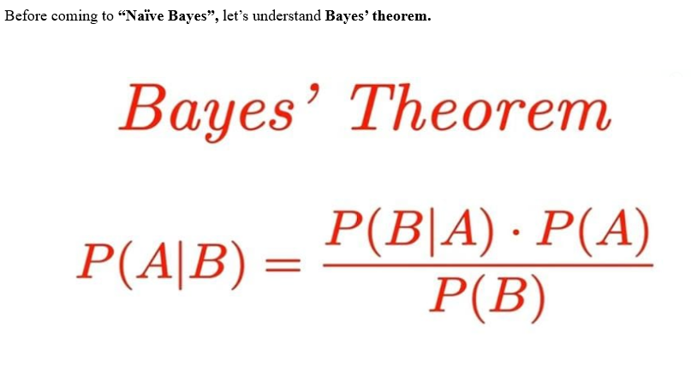
Naïve Bayes

Slide 7
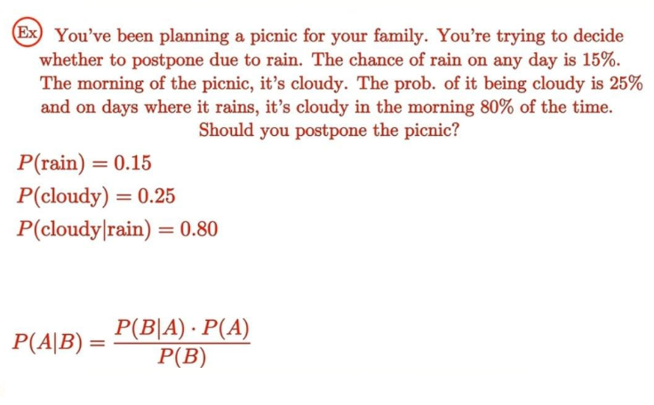

Slide 8
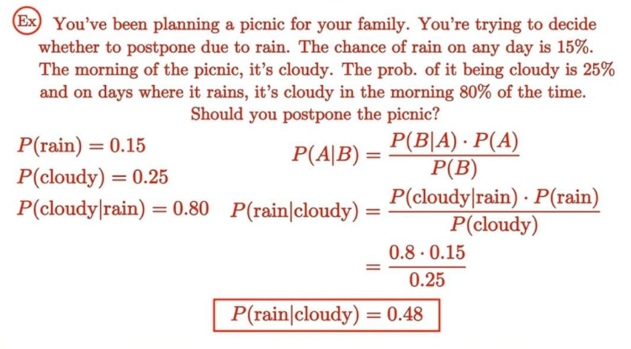

Slide 9
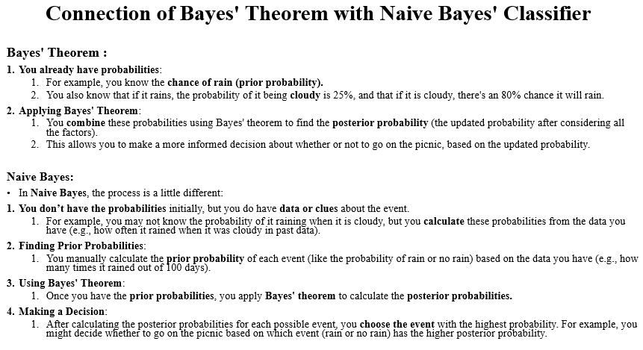
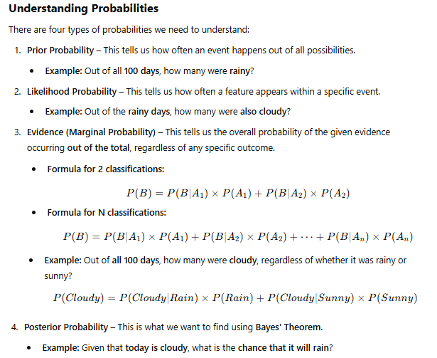
Before understanding connection between Naïve Bayes & Bayes' theorem, let's understand different types of probability.

Slide 10
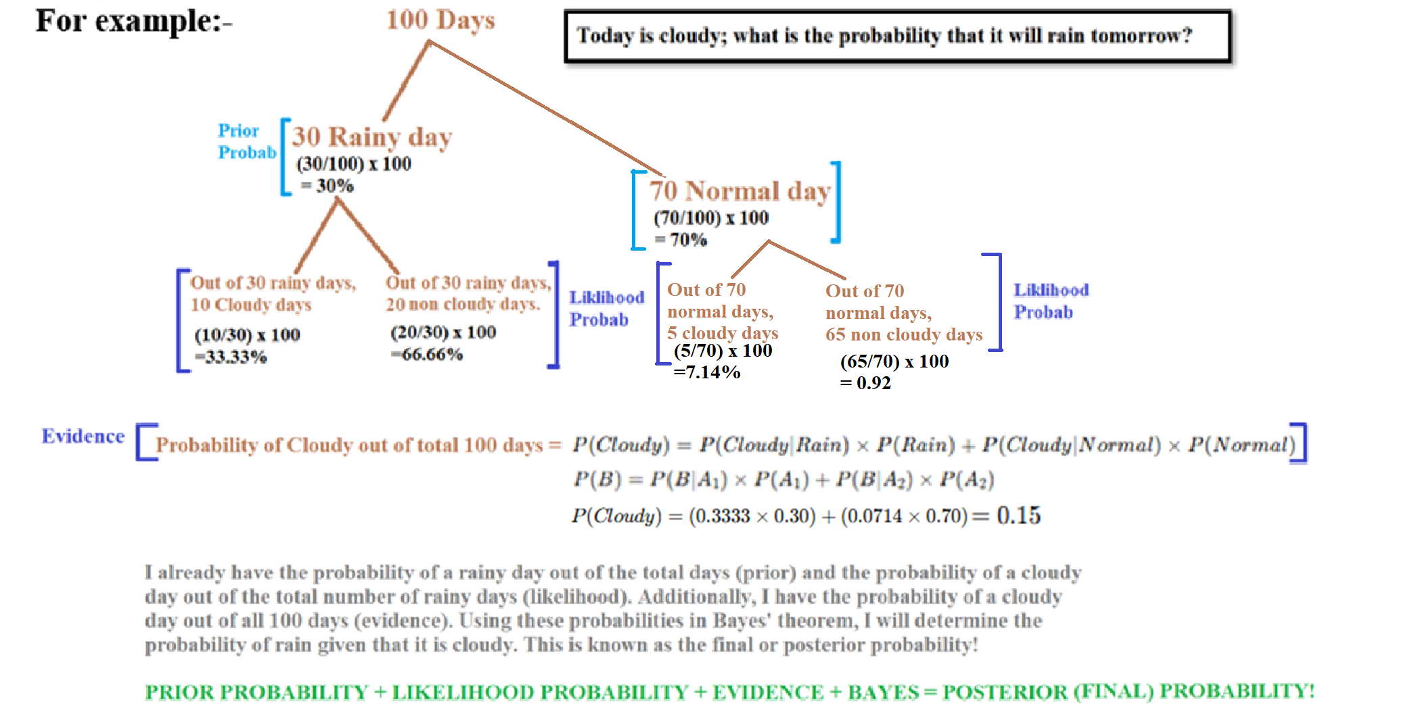

Slide 11
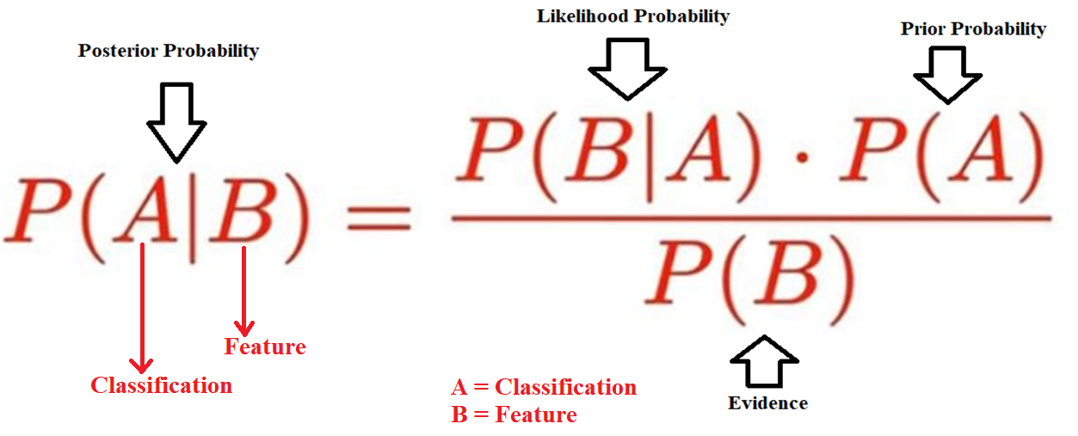

Slide 12
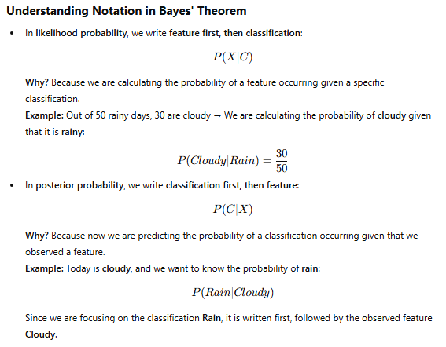

Slide 13
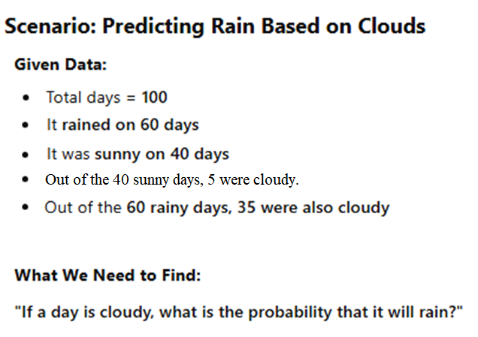
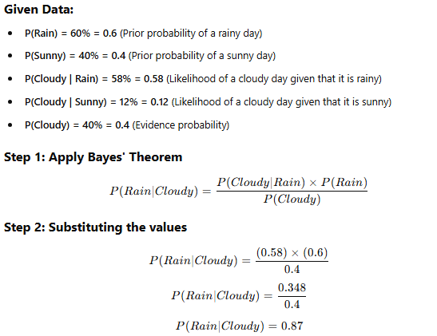
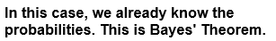
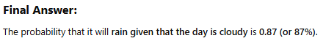
In the given data, the probability of a rainy day is 60%, the probability of a sunny day is 40%, the probability of a cloudy day when it is rainy is 58%, and the probability of a cloudy day when it is sunny is 12%. Additionally, the probability of a cloudy day is 40%. Find the probability that it will rain if the day is cloudy.

Slide 14
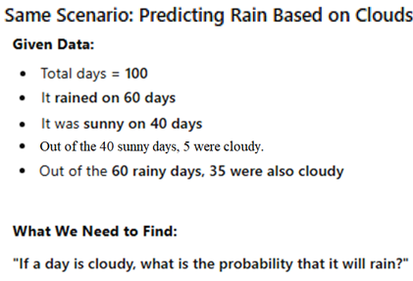
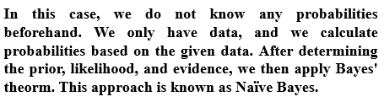
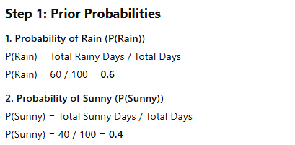

Slide 15
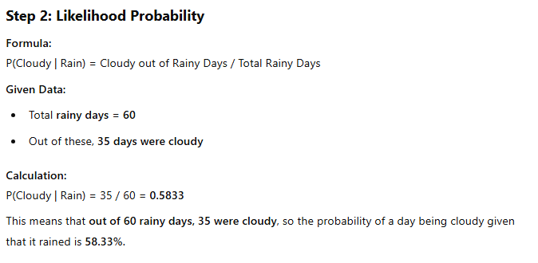
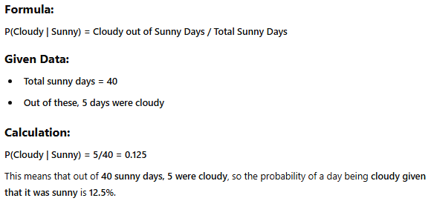

Slide 16
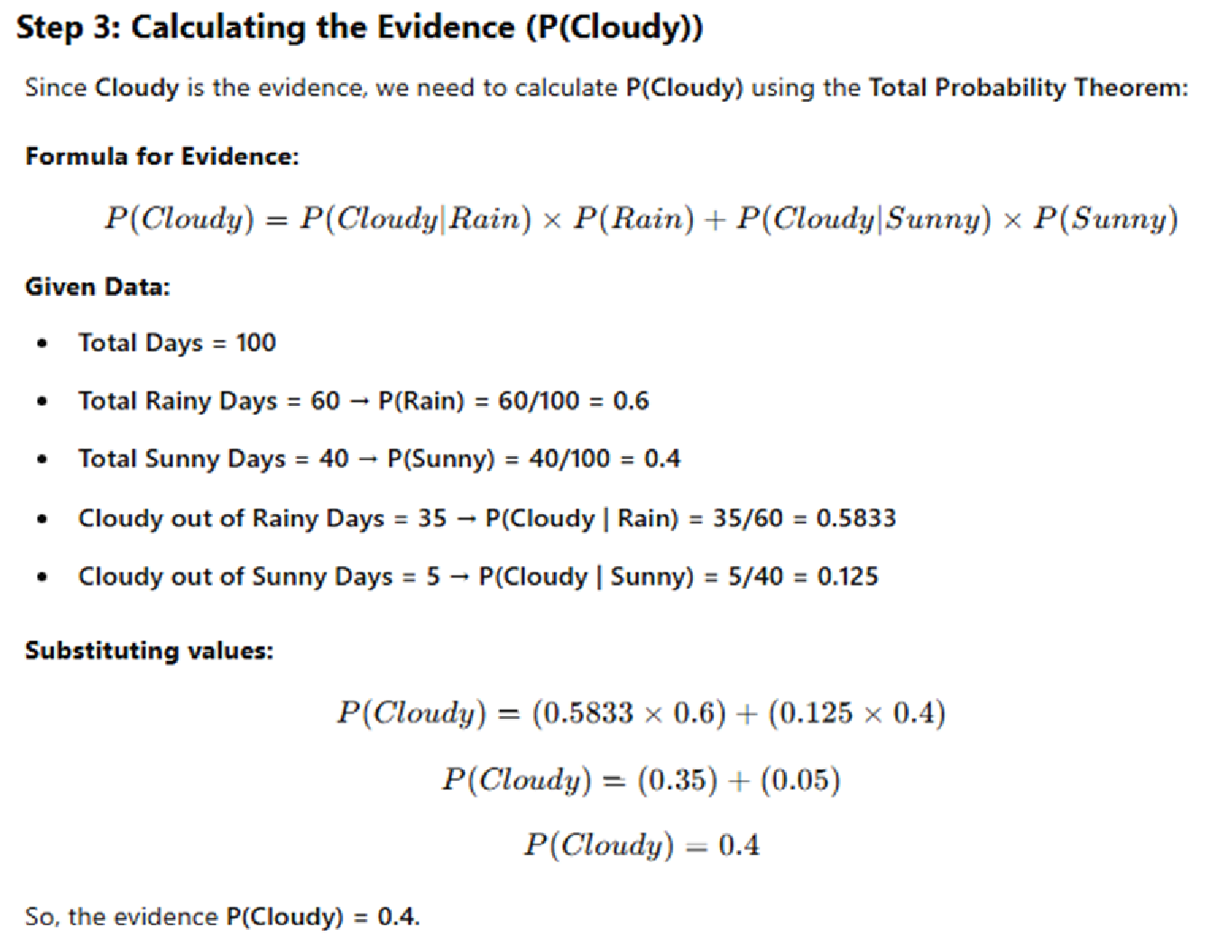

Slide 17
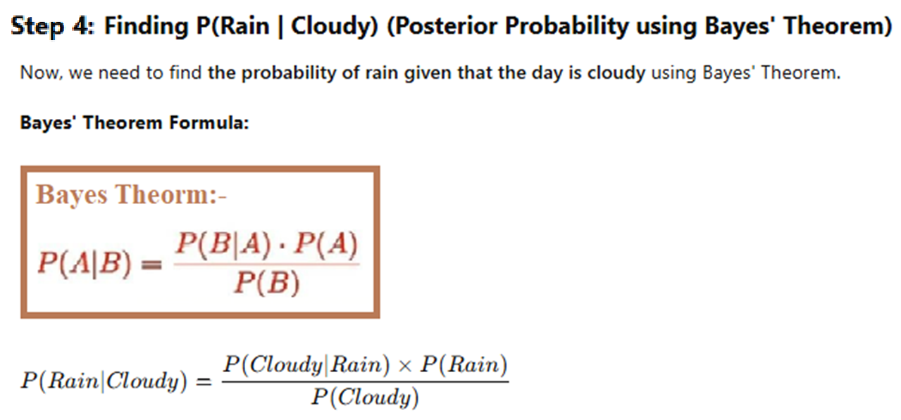

Slide 18
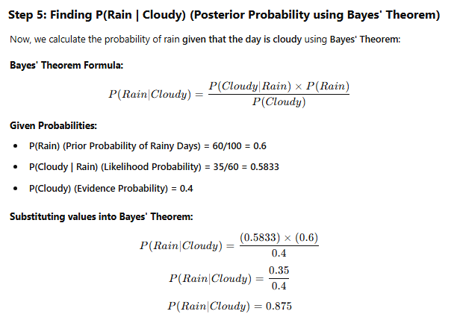
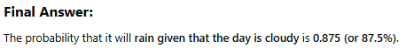

Slide 19
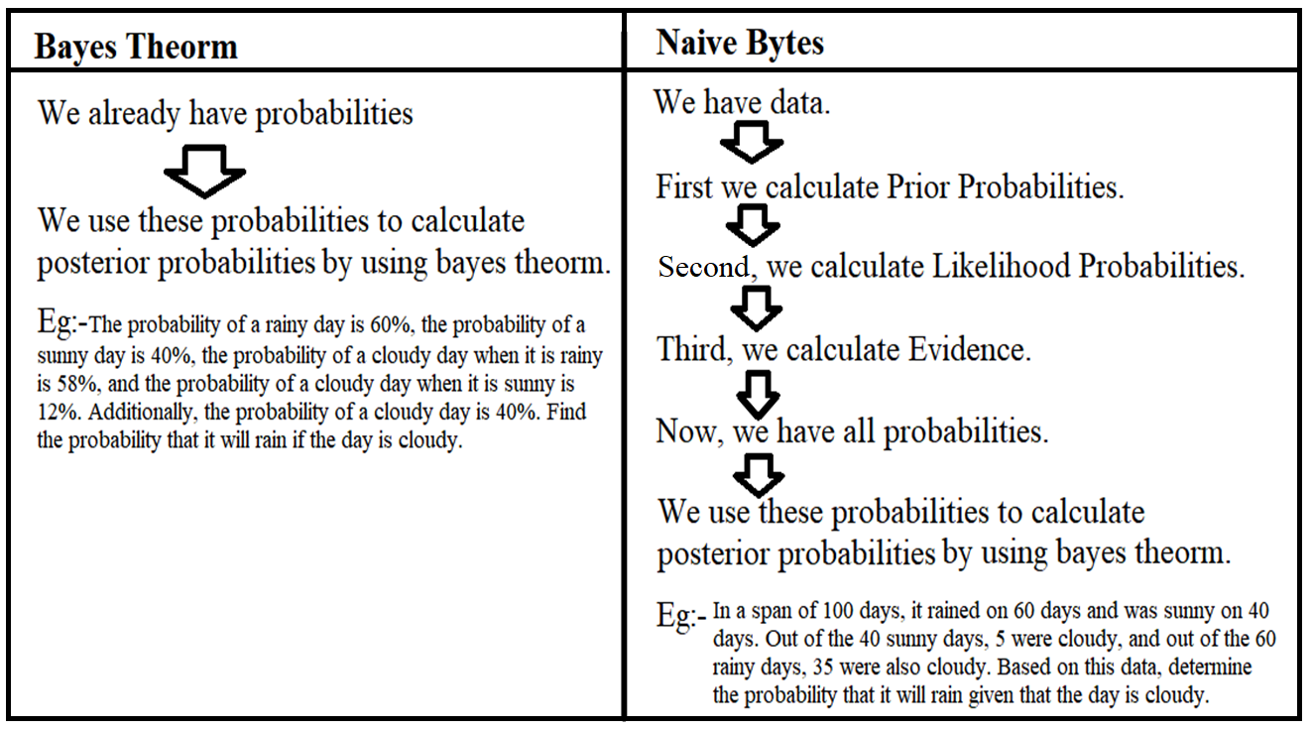

Slide 20
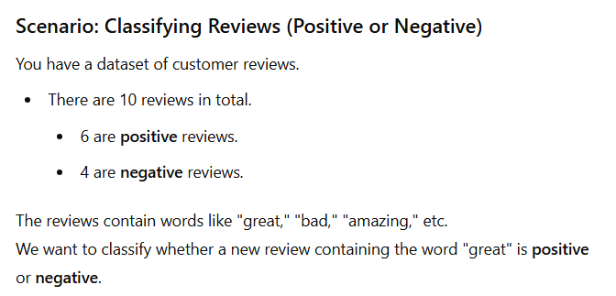
Let’s solve another example (Naïve Bytes):-

Slide 21
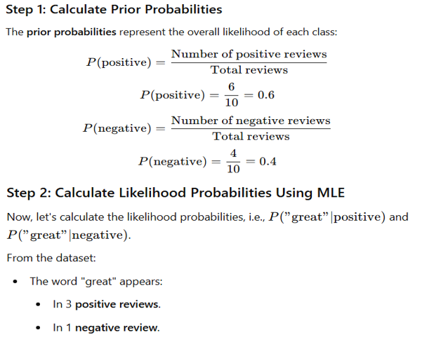

Slide 22
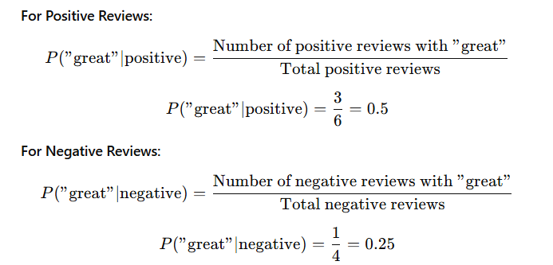
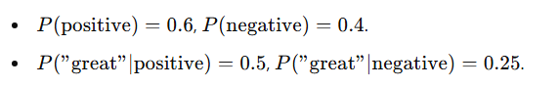

Slide 23
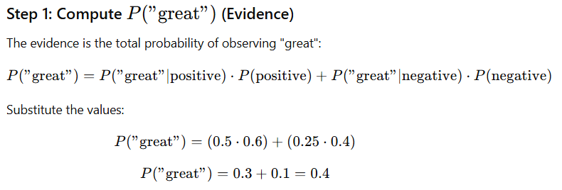

Slide 24
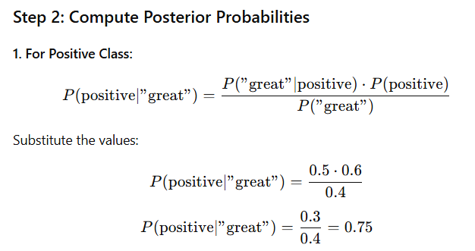
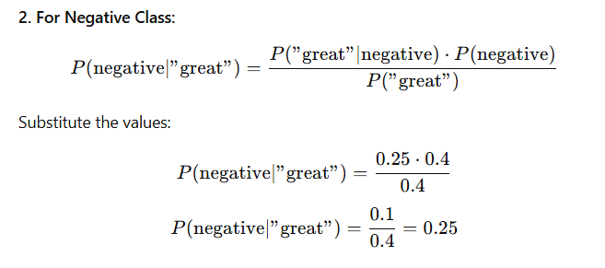

Slide 25
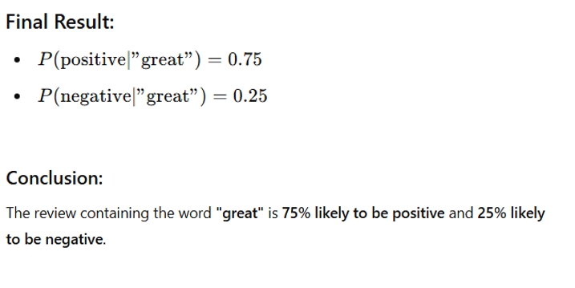

Slide 26
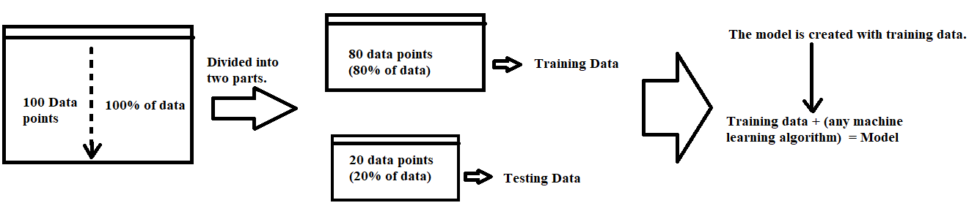
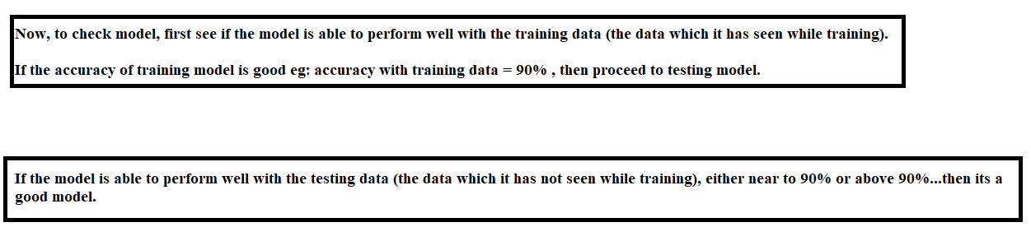
Diagnostics of a Classifier
First, before understanding the diagnostics of a classifier, let's first understand how a model is created after dividing a dataset into two parts.

Slide 27
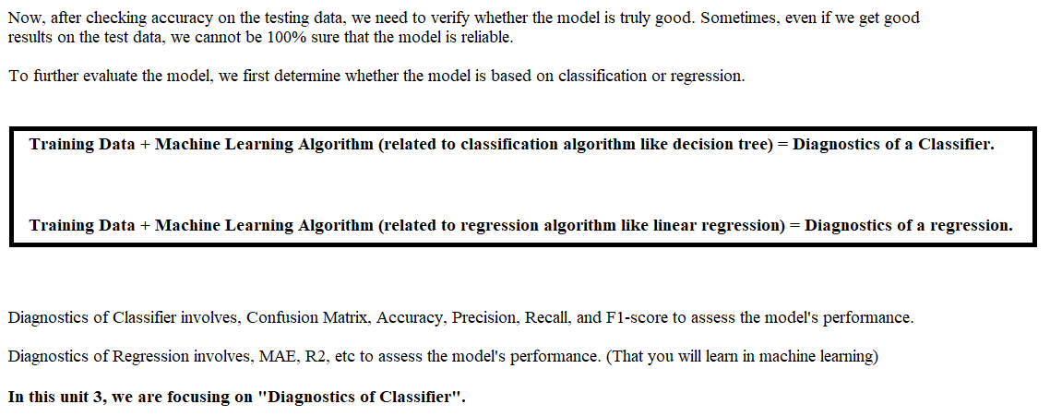

Slide 28
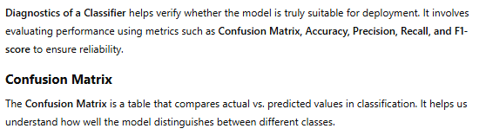
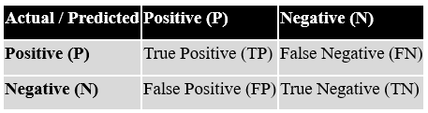
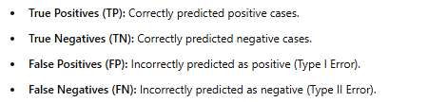

Slide 29
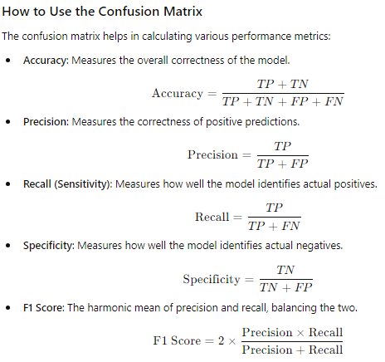

Slide 30
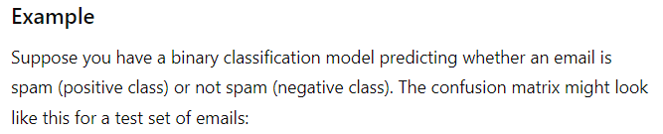
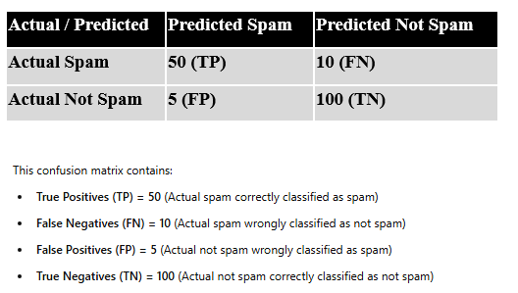

Slide 31
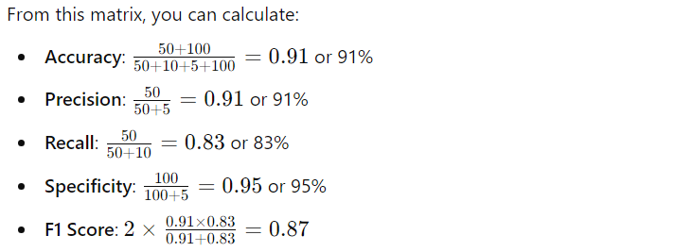
If Accuracy, Precision, Recall, Specificity, and F1-score are all above 80%, the model is generally considered good.
Generally, 80% is kept as a threshold to determine whether the model performs well. In this example, all are above 80%, so the model is good and can be launched.

Slide 32
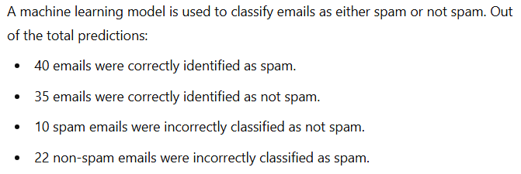
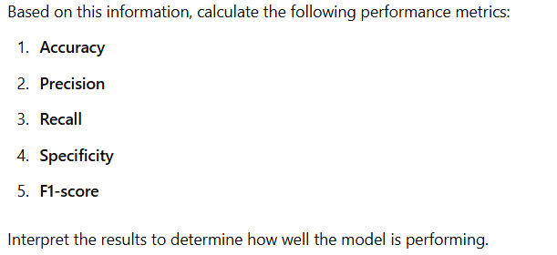
Another numerical example:-

Slide 33
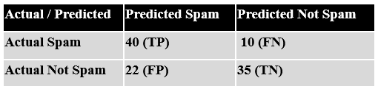
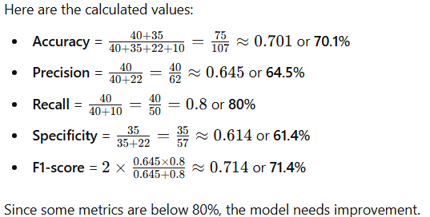

Slide 34
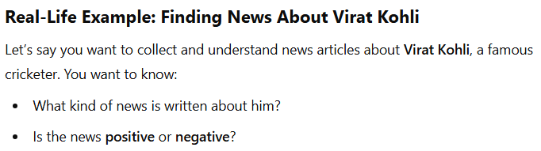

Text Analysis

Slide 35


Slide 36



Slide 37


Slide 38





Slide 39
TF-IDF
Consider the following 3 documents after preprocessing (removing stop words, punctuation, and converting to lowercase):
• Doc1: "The Machine learning is amazing!"
• Doc2: "Deep learning is the Subset of Machine learning"
• Doc3: "Artificial Intelligence is related to machine Learning."
Using the TF-IDF algorithm, determine the most important term in the documents.

Slide 40


Slide 41


Slide 42


Slide 43



Slide 44



Slide 45



Slide 46


Slide 47


Time Series Analysis

Slide 48



: Daily Weather Record

Slide 49

Box-Jenkins Methodology

Slide 50



Slide 51


ARIMA

Slide 52


For example, I want to use ARIMA to predict the sales for the 6th month.

Slide 53



